Slide 1
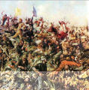
Battle at the Little Bighorn

Slide 2
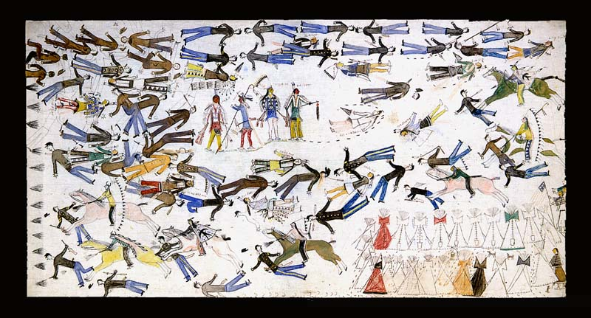
The Laramie Agreement
In late 1875, Sioux and Cheyenne Indians were angered at the whites travelling into their sacred lands in the Black Hills.
To avoid disputes with the Indian tribes the U.S. Govt. Made treaties to recognize Indians rights to most of the Great Plains.
But, gold had been reported in the Black Hills and miners entered the region unconcerned with the treaty.

Slide 3
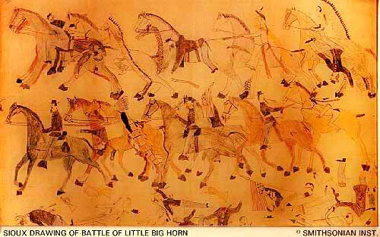
Promises Broken
With promise after promise broken by the government, the Sioux gathered with Sitting Bull to fight for their lands, leaving their assigned reservations.

Slide 4
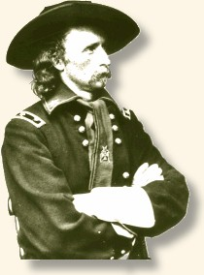
CUSTER
I was a
great Civil
War leader
To force the large Indian army back to the reservations, the Army sent Lt. Colonel George Custer and the Seventh Cavalry.
Spotting the Sioux village about fifteen miles away along the Rosebud River on June 25, Custer also found a nearby group of about forty warriors.

Slide 5
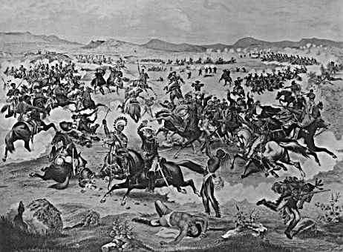
Out Numbered
Ignoring orders to wait, Custer decided to attack before the Calvary could alert the main party.
He did not realize that the number of warriors in the village numbered three times his strength.

Slide 6
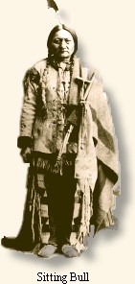
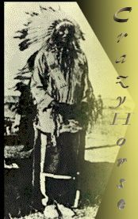
Crazy Horse
Cheyenne and Hunkpapa Sioux together crossed the river and slammed into the advancing soldiers, forcing them back
Meanwhile, another force, largely Oglala Sioux under Crazy Horse's command, surrounded Custer and his men. They began pouring in gunfire and arrows.
Sitting Bull had many followers!

Slide 7
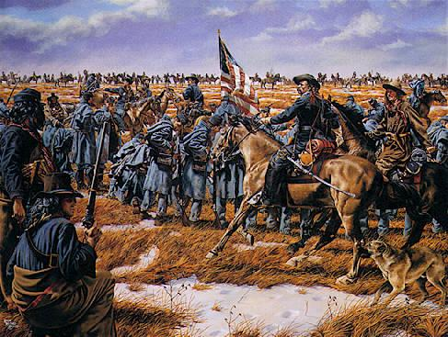
Last Stand
As the Indians closed in, Custer ordered his men to shoot their horses and stack the carcasses to form a wall, but they provided little protection against bullets.
In less than an hour, Custer and his men were killed in the worst American military disaster ever.
Custer’s last stand!

Slide 8

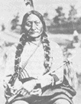
REVENGE
Little Bighorn showed the Indians' power. They had achieved their greatest victory
Outraged over the death of a popular Civil War leader the US Government was determined to fight back.

Slide 9

Custer’s Last Stand

Slide 10
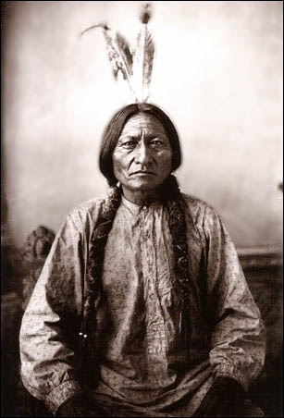
Sitting Bull
Enduring harsh punishment Sitting Bull was detained as a prisoner of war at Fort Randall from '81 - '83. He was later released.
In 1885, Sitting Bull traveled around the world as a star performer with Buffalo Bill Cody and his Wild West Show
In 1890, Sitting Bull was killed by Red Tomahawk who was one of the Sioux police sent by Agent James McLaughlin.

Slide 11


Slide 12
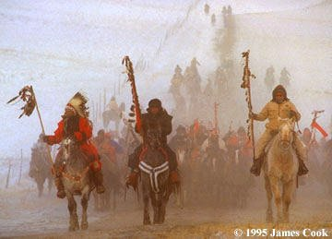
Tension was running high following the the murder of Sitting Bull. The Miniconjou Hunkpapa Sioux Indians left the reservations and head toward the Badlands.

Slide 13
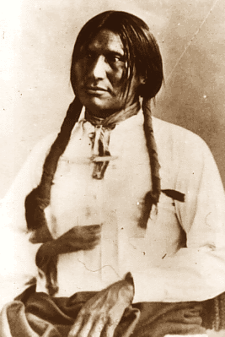
Massacre at Wounded Knee
Months after the death of Sitting Bull, small battles arose around the Dakota territories.
U.S. Calvary was on the look out for any rebel Sioux leaders, one of whom was Big Foot.
When the Calvary found him, he was in poor health and surrendered peacefully.

Slide 14
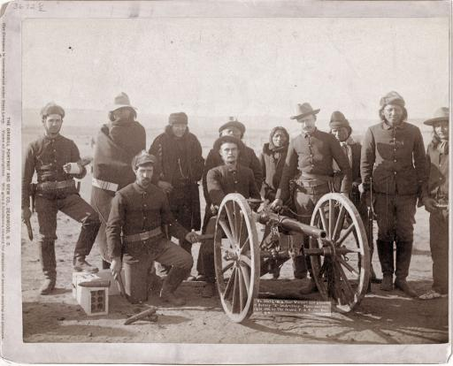
He had the misfortune to fall into the hands of the seventh Calvary. They brought the Big Foot and his band to a campsite near Wounded Knee, already well within the borders of the reservation.

Slide 15
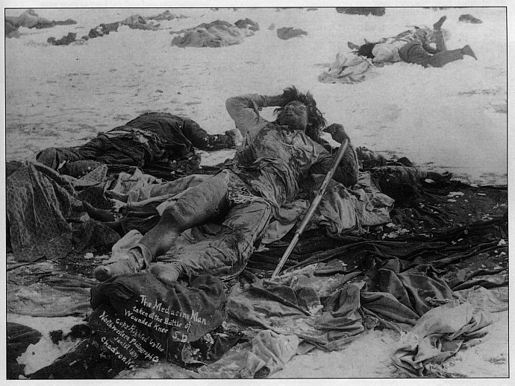
No one knows what caused the disturbance, no one claims the first shot, the Wounded Knee Massacre began fiercely with the Hotchkiss guns raining fragmentation shells into the village at a combined rate of 200 or more rounds a minute. The 500 well armed Cavalry Troopers were well positioned using crossing fire to methodically carry out what is known as the Wounded Knee Massacre.

Slide 16
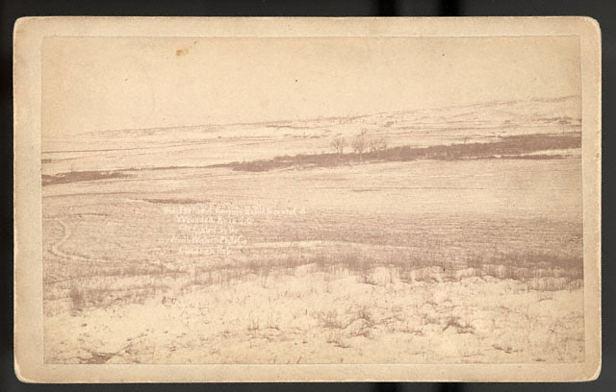
Almost immediately most of the Sioux Indian men were killed. A few Sioux killed 29 soldiers and wound 39 more. Resisting was pointless, as long as an Indian moved, the guns kept firing. Unarmed Sioux Indian Women and children were mercilessly massacred. A few ran as far as three miles only to be chased by the Cavalry and put to death

Slide 17
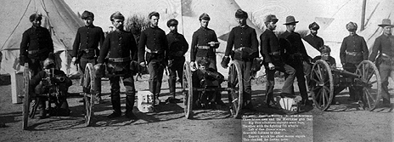
Officers and men were revengeful and trigger-happy.. The Hotchkiss guns were pouring shells into groups of mothers and children.

Slide 18
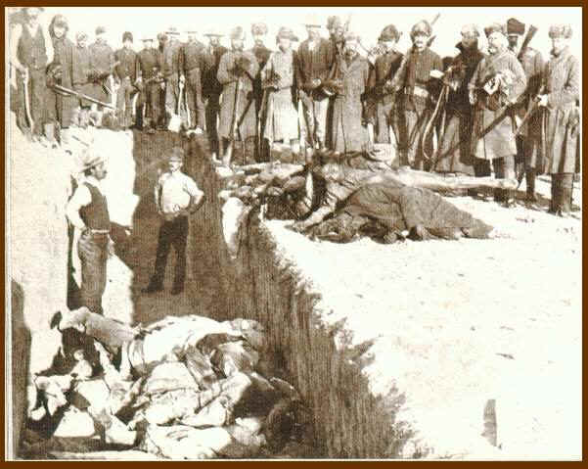
Of the original 350 Indians one estimate stated that only 50 survived. Almost all historical statistics report over 200 Indians being killed on that day. Government figures only reported the Indian dead as 64 men, 44 women and girls, and 18 babies. All of the bodies were buried in one communal grave.

Slide 19
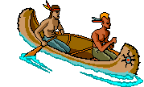
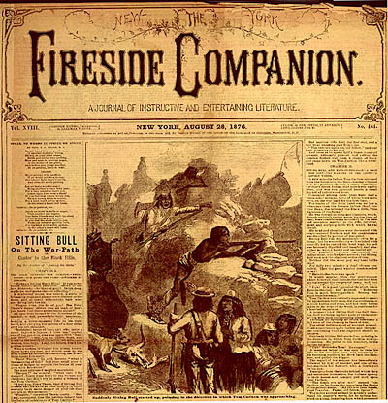
Massacre or Defense

Slide 20
Massacre at Wounded Knee

Slide 21
Massacre at Wounded Knee

Slide 22
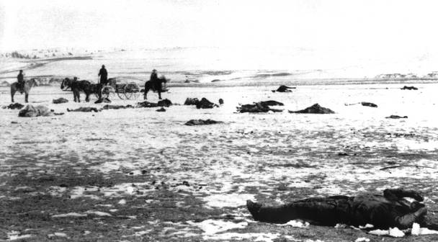
Causes and Consequences
Causes- The reason why something happened
Consequences- The result of something happening

Slide 23
A) 1872 Gold Discovered in the black Hills
G) Sitting Bull became the most famous Indian chief
H) US Government did not stop the miners entering the Black Hill
B) Sioux, Cheyennes, Arapahos United
C) Battle of Wounded Knee
I) US Government planned to defeat the Indians
D) Defeat of the 7th Cavalry
J) Indians sent to reservations
E) Many Indians fled to Canada
K) A famous Indian Victory
F) Red clouds peace treaty ignored
L) US troops sent in to control miners
M) Black Hills sacred-invaded by white miners

